Slide 1
Security for E-Government

Slide 2
Introduction
In fact, the security is one of the most significant challenges for implementing e-government initiatives.
Many studies have found that security is one of the most important obstacles.
Security means protection of all information and systems against any disclosure to unauthorized access, or unauthorized modifications or devastation
Thus, it refers to protection of the information systems, assets and the control of access to the information itself.
It is a vital component in the trust relationship between citizens and government.
Security issues may present the largest obstacle to the development of e-government services.
Thus, security policies and standards that meet citizen expectations are an important step toward addressing these concerns .

Slide 3
Introduction
The use of security solutions, including digital signatures, encryption, user names, passwords, customer unique numbers, bank account numbers, and others being transmitted over the Internet and stored electronically can help in fulfilling security goals in e-government applications.
  Furthermore, point out that information security, referred to as cyber security or computer security, is an important e-government challenge.
In addition, security involves continuous vigilance and protection against the increasing danger of worms and viruses.
Also, people need to be educated on the importance of security measures, such as private passwords, to ensure their own protection.
Cyber security has to deal with cyber regulations on different fields such as e-Commerce, e-Banking, e-Government and e-Healthcare, and all these depend on the governance of cyberspace to facilitate the use of web as a medium to promote global interchange without risk.

Slide 4
Security of e-governance
Implementation of E-governance has changed the way of living of the people in various countries.
At present scenario we can say our most activities or needs are totally depend upon the E-governance, that’s why security of E-governance is a major issue.
Here we try to explain an approach for E-governance security which is based on specially two terms i.e. “Security of What?” and other is “Security against What?” in this section we try to work on these two questions
Security of What?
  This is a major question when we talk about E-governance security.
Security is all about protecting the Information and Communication Technology (ICT) assets of an organization

Slide 5
Security of e-governance
Security against What?
There are various threats to security of our ICT system, and we can’t define or declare them exactly, it may come from various sources and in various forms.
  So it is very necessary for e-governance administrator to identify these threats.
In this section we firstly give some sources of threats and then some types of threats which affect to E-governance.
Sources of Threat
The sources of threat can be internal or it can be external to the government body.
There are various internal sources of threat like the employees who work on the E-governance project, customers of the E-governance projects they may attempt to access the databases for their personal financial profit.
When we talk about external sources it may be Professional hackers, Criminal organizations, various Intelligence agencies or Investigation agencies

Slide 6
Security of e-governance
Types of Threat
Threats may include unauthorized access, modification, and destruction of data.
The threats may be of different types varying from time to time because technology changes frequently.
The attacks on security of e-governance system can be in different forms including Defacing of web sites, Hacking, Cracking, Damage to critical database and applications, Network security check list, Viruses and Malwares etc. the damage of ICT assets need not always be a result of such malicious attacks as mentioned previously.
It may be some kind of natural or environmental disasters etc.

Slide 7
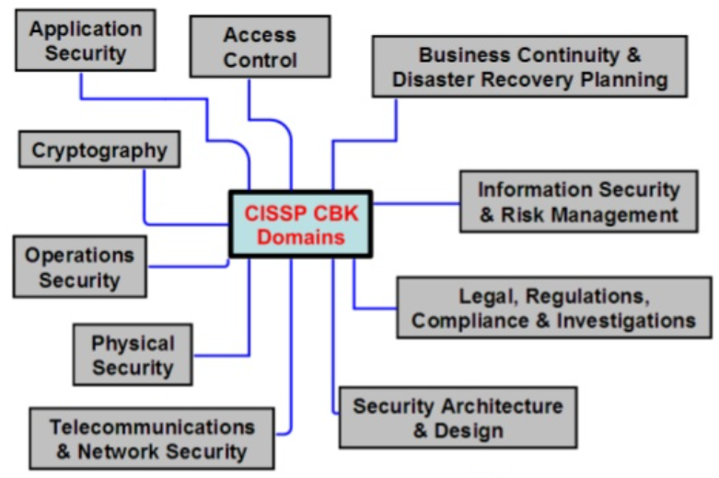
Domains of Security
CISSP CBK: Certificate Information System Security Professional Common Body of Knowledge

Slide 8
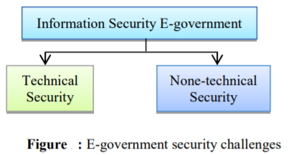
E-government security challenges
The security framework of e-government consists on the main three elements; people, processes and technologies.
Our focus would be on the E-government information security in terms of the technological and non-technological perspectives.
Since, E-government cannot be only the protection of the ICT assets in government bodies.
However, it can be defined as a protection of both technical and non-technical assets of the government departments.
Therefore, security of e-government can be in a broad area as illustrated in figure

Slide 9
Challenges
Cybersecurity Threats: E-government systems face a wide range of cyber threats, including malware, phishing attacks, ransomware, and distributed denial-of-service (DDoS) attacks. These threats can disrupt services, steal sensitive data, or compromise the integrity of government systems.
Data Privacy: E-government platforms often handle large amounts of personal and sensitive information. Ensuring the privacy and confidentiality of this data is essential to protect citizens' rights and prevent identity theft or unauthorized access.
Complexity of Systems: E-government initiatives typically involve complex systems and interconnected networks, making them vulnerable to security vulnerabilities and misconfigurations. Managing security across these diverse systems can be challenging, especially when integrating legacy systems with newer technologies.
Insider Threats: Insider threats, whether intentional or accidental, pose a significant risk to e-government security. Employees or contractors with privileged access to government systems may abuse their privileges, leak sensitive information, or inadvertently introduce security vulnerabilities.
Compliance and Regulations: E-government initiatives must comply with various regulations and standards related to data protection, privacy, and cybersecurity. Ensuring compliance with these requirements adds complexity to security management and may require substantial resources.

Slide 10
Security Approaches
Risk Assessment and Management: Conducting regular risk assessments helps identify potential security threats and vulnerabilities within e-government systems. By prioritizing risks and implementing appropriate controls, government agencies can mitigate security risks effectively.
Security by Design: Implementing security measures from the design phase of e-government projects helps build robust security foundations. This includes incorporating security features such as encryption, access controls, and authentication mechanisms into system architecture and development processes.
Access Control and Authentication: Implementing strong access control measures, such as role-based access control (RBAC) and multi-factor authentication (MFA), helps prevent unauthorized access to government systems and sensitive data.
Continuous Monitoring and Incident Response: Adopting continuous monitoring tools and practices allows government agencies to detect security incidents promptly and respond effectively. Establishing incident response plans and conducting regular security drills help ensure a rapid and coordinated response to cyber threats.
Education and Training: Providing cybersecurity awareness training to government employees and contractors helps raise awareness about security best practices and reduces the risk of insider threats. Training programs should cover topics such as phishing awareness, secure password management, and data handling procedures.

Slide 11
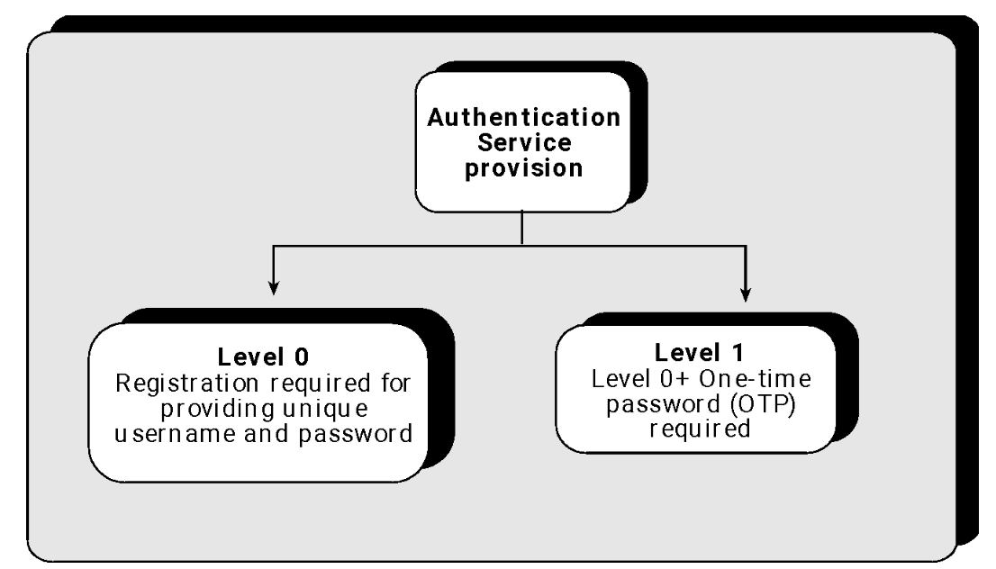
E-GOVERNMENT PRESENT SECURITY APPROACH

Slide 12
Registration
  Registration is the process for accessing restricted services/documents.
Authentication Service
  Level 0: This is the basic authentication mechanism using username and password.
  Level 1: At Level 1, a user will be able to prove her/his identity using OTP token along with his/her Unique Identification Card number (UID) credentials.
  Level 2: At Level 2, the user would need to prove his/her identity through a hardware or software token (along with PIN).
  Level 3: At Level 3, the user will prove his/her identity using biometrics authentication.
  Refer figure of book for enhance security system

Slide 13
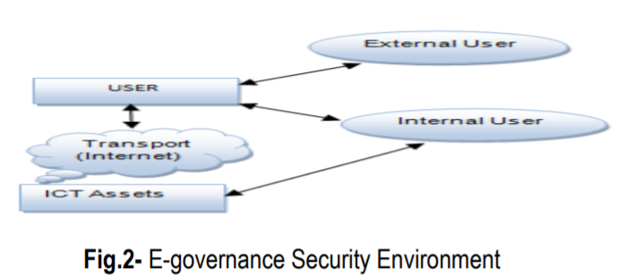
Security Management Model
A security management model is meant to be a generic description of what an organization should do to provide a secure environment for itself.
security of the e-governance system has to be managed systematically in three levels, this model is explained with the help of this figure

Slide 14
Security Management
Security at User Level
Security at user level is a very important issue.
We can classify user level security management in three Parts.
Identity Management
  The main purpose of this is to create unique digital identity or credential to all legal users by providing a unique user name and password, to create and manage ICT systems which ensure that the digital identities are secure.
Access Management System
  In this level the unique credentials which are provided to the user at identity level are matched to identify the user, that he/she is actually the authentic person.

Slide 15
Security Management
Interaction Management System
  Interaction management is a most comprehensive and complex phase.
  It includes assurance of the Integrity, Confidentiality and Non-repudiation principles of a comprehensive security.
In user level, we can use various tools such as digital identity token, public key infrastructure (PKI), digital signature, asymmetric key cryptography etc. to provide or enhance the security at the user level.

Slide 16
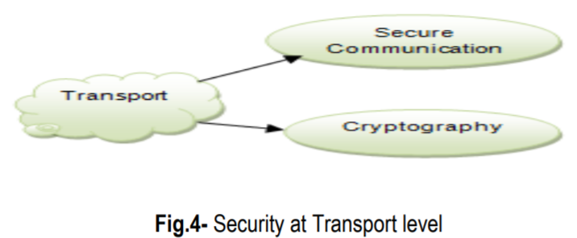
Security Management
Security at Transport Level
  In this level we consider about e-governance security in two aspects which are security within LAN and WAN, and the second one is Security over the Internet.
This security level is classified into two systems, i.e. Secure Communication System and Cryptographic System.

Slide 17
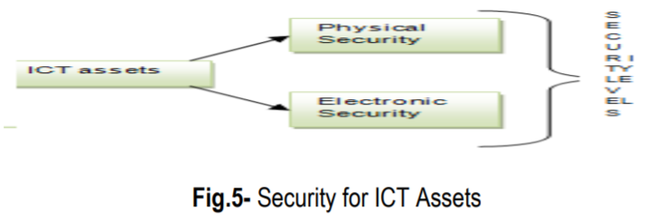
Security Management
Security at ICT Assets level
  ICT assets are the most precious for any organization or institution, so to secure this level we have two broad categories of security treatment i.e. Physical security and Electronic security
Physical Security
  It is used to protect the data against physical damages or losses like- natural disasters etc.
  To protect data in this security level we take some steps such as security level of data centers are highly secured by using biometric-controlled system, in data centers provision of dust-proof environment, fire protection systems, security alarms, CCTV monitoring of data center, automated backup system

Slide 18
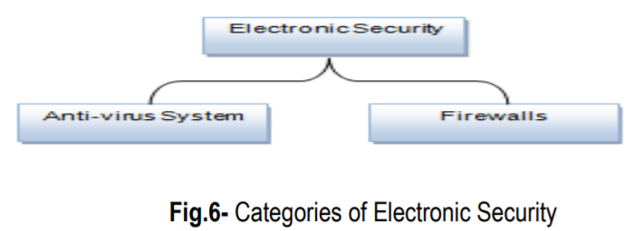
Security Management
Electronic Security
  To give the protection against digital threats we use electronic security.
We have various electronic security tools, and we can manage them in two categories
Anti-virus System
When we discuss about digital threats the first thing in our mind is virus, which affects our ICT assets in various ways such as slowing down of the system, occupy disk space, corrupt valuable data or storage medium etc.
It is also known as malware, worms and Trojan horses.
There are “over 1,122,311 known viruses active in the world as of 2008

Slide 19
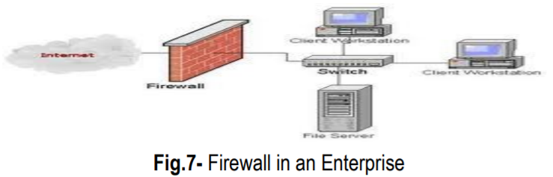
Security Management
Firewalls “A system designed to prevent unauthorized access to or from a private network”.
A firewall is a security device that can be hardware or software that is mainly use for to separate a secure area from a less secure area and to control communications between the two.
We have several firewall techniques such as Packet filter, Application gateway, Circuit-level gateway, Proxy server.
There are many different brands of software firewalls, some of them areZoneAlarm, BlackICE and Kerio etc.

Slide 20
ACCESS CONTROL MODEL
Access control models for e-government systems are crucial for ensuring that only authorized individuals have access to government resources and information.
  Role-Based Access Control (RBAC)
  Attribute-Based Access Control (ABAC)
  Mandatory Access Control (MAC)
  Discretionary Access Control (DAC)
  Rule-Based Access Control (RBAC)

Slide 21
Role-Based Access Control (RBAC)
  RBAC is a widely used access control model that assigns permissions to users based on their roles within an organization.
  In the context of e-government, users are typically assigned roles such as citizen, government employee, administrator, etc. Permissions are then granted based on these roles, allowing users to access only the resources and information necessary for their designated roles.
Attribute-Based Access Control (ABAC)
  ABAC is a more flexible access control model that considers various attributes of users, resources, and the environment when making access control decisions.
  Attributes such as user roles, department, time of access, location are taken into account.

Slide 22
Mandatory Access Control (MAC):
  MAC is a strict access control model where access decisions are based on security labels assigned to both users and resources. Users and resources are assigned sensitivity labels (e.g., confidential, secret, top secret), and access is granted or denied based on predefined security policies. MAC is commonly used in government and military settings where data confidentiality is paramount.
Discretionary Access Control (DAC)
  DAC is a more flexible access control model where resource owners have the discretion to control access to their resources. Resource owners can grant or revoke access permissions as needed, providing greater autonomy but also requiring careful management of access rights.
Rule-Based Access Control (RBAC)
  RBAC is an access control model that uses rules or policies to govern access decisions. Rules define conditions under which access is granted or denied, based on factors such as user attributes, resource attributes. RBAC is suitable for e-government systems with complex access control requirements that cannot be adequately addressed by simpler models.

Slide 23
NIST CONTROL MODEL
The NIST (National Institute of Standards and Technology) Cybersecurity Framework provides a comprehensive set of guidelines, best practices, and controls for managing and improving cybersecurity posture within organizations. It includes a set of controls and recommendations that organizations can implement to enhance their cybersecurity defenses. These controls are organized into several categories based on the functions of the framework: Identify, Protect, Detect, Respond, and Recover.
Identify:
  Risk Assessment: Conduct regular risk assessments to identify, prioritize, and mitigate cybersecurity risks to the organization.
Protect:
  Access Control: Implement and enforce access controls to ensure that only authorized users and systems can access sensitive information and resources.

Slide 24
NIST…
Detect:
  Anomalies and Events: Implement monitoring and detection mechanisms to identify and respond to cybersecurity incidents and suspicious activities in a timely manner.
Respond:
  Response Planning: Develop and implement incident response plans and procedures to effectively respond to and recover from cybersecurity incidents.
Recover:
  Recovery Planning: Develop and maintain continuity of operations and disaster recovery plans to ensure timely recovery of information systems and data following cybersecurity incidents.

Slide 25
TECHNICAL MODEL
Bell-LaPadula Model
Biba Model
Clark- Wilson Model
Chinese Wall Model
Graham-Denning Access Control Model

Slide 26
Bell-LaPadula Model
The BLP model is primarily concerned with enforcing confidentiality policies, particularly in multi-level security environments where information is classified into different sensitivity levels
The BLP model defines security levels for both subjects (users or processes) and objects (resources or data).
Security levels are typically hierarchical and consist of a set of ordered sensitivity levels, such as "Top Secret," "Secret," "Confidential," and "Unclassified."
The Simple Security Property (no read-up) states that a subject at a certain security level (e.g., "Secret") cannot read data at a higher security level (e.g., "Top Secret").
The Star Property (no write-down) states that a subject at a certain security level cannot write data to a lower security level.
The BLP model introduces a *-property, which ensures that subjects with the same security level cannot interfere with each other's access to objects.

Slide 27
Biba Model
It primarily focuses on integrity rather than confidentiality, although it can be used in conjunction with other models to provide comprehensive security. The Biba model is particularly useful in environments where data integrity is of utmost importance, such as financial systems, critical infrastructure, and healthcare.
Similar to the Bell-LaPadula model's security levels, the Biba model defines integrity levels for both subjects (users or processes) and objects (resources or data).
Integrity levels are often represented as labels and typically follow a hierarchical structure, such as "Low," "Medium," and "High."
The Simple Integrity Property (no read-down) states that a subject at a certain integrity level should not read data from objects at a lower integrity level.
The Star Integrity Property (no write-up) states that a subject at a certain integrity level should not write data to objects at a higher integrity level.
The Biba model also includes a concurrency property, which ensures that subjects with the same integrity level cannot concurrently modify objects to maintain the integrity of the system.

Slide 28
Clark- Wilson Model
The Clark-Wilson model is a formal security model designed to address integrity in information systems, particularly in commercial environments where data consistency and correctness are critical. It was developed by David D. Clark and David R. Wilson in 1987., the Clark-Wilson model focuses on ensuring that data remains accurate and consistent throughout its lifecycle.
Access Control Triple:
The Clark-Wilson model uses an access control triple to regulate access to data and operations. This triple consists of:
  Constrained Data Item (CDI): Data items that are subject to integrity constraints and can only be modified through authorized transactions.
  Transformation Procedure (TP): Procedures or programs that manipulate CDIs to ensure integrity.
  Integrity Verification Procedure (IVP): Procedures that verify the integrity of transactions and data manipulations performed by TPs.

Slide 29
This separation helps prevent unauthorized or fraudulent activities by requiring multiple parties to collaborate for certain operations.
An enforcement mechanism ensures that only certified TPs and IVPs are used in the system, preventing unauthorized or malicious modifications to data.
The Clark-Wilson model emphasizes the importance of auditability by maintaining a detailed audit trail of all transactions and data manipulations.

Slide 30
Chinese Wall Model
The Chinese Wall model, also known as the Brewer and Nash model, is a security model designed to address conflicts of interest in access control policies, particularly in commercial environments where confidentiality and data segregation are critical. It was introduced by David D. Clark, David R. Wilson, and Jerome H. Saltzer in 1978. The model is named after the concept of a "Chinese Wall" used in business and legal contexts to prevent conflicts of interest.
Conflict of Interest:
  The Chinese Wall model addresses scenarios where individuals or entities may have access to sensitive information from multiple competing organizations or entities. For example, in financial services, a consultant may have access to confidential information from multiple clients, and there could be conflicts of interest if the consultant uses information gained from one client to benefit another.

Slide 31
Data Segregation:
  The model focuses on segregating data into distinct categories or "compartments," where each compartment represents a set of information related to a particular organization or entity.
  Access to data within each compartment is restricted to authorized users who have not previously accessed data from competing compartments. This restriction aims to prevent conflicts of interest and unauthorized information disclosure.
Access Control Policy:
  The Chinese Wall model employs a dynamic access control policy that dynamically enforces access restrictions based on the user's previous access history.
  When a user accesses information from a particular compartment, the model ensures that the user is subsequently restricted from accessing information from competing compartments to prevent conflicts of interest.

Slide 32
Graham-Denning Access Control Model
The Graham-Denning Access Control Model is a formal model for specifying and analyzing access control policies in computer systems. It was introduced by R.M. Graham and D.C. Denning in 1972. This model provides a framework for defining access control rules and mechanisms to enforce security policies within a computer system.
Entities:
  The model defines several entities, including subjects (users or processes), objects (resources or data), and rights (permissions or operations).
Protection State:
  The protection state of the system is represented by a set of access control rules that specify the allowable operations that subjects can perform on objects.
Access Control Matrix:
  The access control matrix is a central concept in the Graham-Denning model. It is a two-dimensional matrix that represents the access rights of subjects to objects.
  Rows of the matrix correspond to subjects, columns correspond to objects, and each cell contains the rights that a subject has over an object

Slide 33
Access Control Operations:
The model defines three fundamental operations to manipulate the access control matrix:
  Grant: Adds rights to a cell in the access control matrix, allowing a subject to access an object.
  Revoke: Removes rights from a cell in the access control matrix, restricting a subject's access to an object.
  Create: Establishes new entries in the access control matrix to define access rights for new subjects and objects.
Security Properties:
The Graham-Denning model defines three security properties:
  Simple Security Property: A subject can access an object only if it has been granted access rights to that object.
  *-Property (Star Property): A subject can pass access rights to another subject only if it possesses those rights.
  Discretionary Security Property: A subject can grant access rights to another subject only if it possesses those rights.

Slide 34
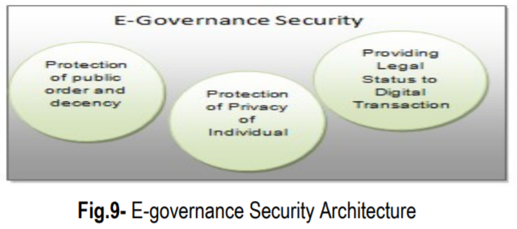
Security Architecture
The security architecture of E-governance is a high level document that set the security goals of e-governance project and describe the procedure that need to be followed by all the e-governance hierarchy such as users, businesses, operators etc.
Appropriate legal framework is absolutely essential for the systematic and sustained growth of e-governance

Slide 35
Protection of Public Order and Decency
The internet is a highly capable of being saturated and versatile medium at the same time.
  Its reach is very vast and due to its multimedia capability its impact can be immediate and profound.
So the government has to beware of its potential to create a negative impact on society through promotion of terrorism, pornography, communalism, violence etc.
Section 67 of the IT Act 2000 of India makes it a punishable offence to “publish or transmit or cause to be published in the electronic form, an material which is lascivious or appeals to the prurient interest or if its effect is such as to tend to deprave and corrupt persons who are likely, having regard to all relevant circumstances, to read, see or hear the matter contained or embodied in it”.
The enormity of the Internet pornography and immense responsibility of governments in intervention can be gauged from the following statistics on the subject, taken from Internet Filter Review 2004, on 24 October 2003:
  Number of pornographic web sites on the internet: 370 million.
  Number of child pornographic web sites on the Internet: 100,000.
  Size of pornographic industry world-wide: US$ 57 billion.
  Size of Internet pornographic industry: US$ 2.5 billion.

Slide 36
Protection of Privacy of Individuals
Disclosure of personal information over the internet raises questions related to the privacy of individuals.
The United States passes an Act which is “The Privacy Act of 1974”.
According to this Act any organization should followed some steps when it gathered any personal information of any individual- Notice, Choice, Onward Transfer and Security

Slide 37
Providing Legal Status to Digital Identities and Transactions
One of the fundamental requirements of e-governance projects is its ability to create and sustain the operations of government agencies as well as private agencies.
So it’s very necessary to consult legal status of entities and actions such as ‘legal status is to be provided to the digital identities’, ‘provide the legal recognition to digital assets’, ‘ provide a digital authority to digital transactions, these transactions could be in the areas of G2G, G2B,G2C etc’. ‘Agreements and contracts in digital form’.
To providing the authority to any legal digital transaction or deal the Indian government gave ‘Information Technology Act 2000’ in October 2000.
It specifically takes care of all the issues mentioned above.
India followed some provisions of ‘Electronic transaction Act 1998 (Singapore)’ closely while drafting the IT Act 2000.

Slide 38
Security Reference Architecture Framework
Is derived and designed to use security measure across the entire government ICT security domain.

Slide 39
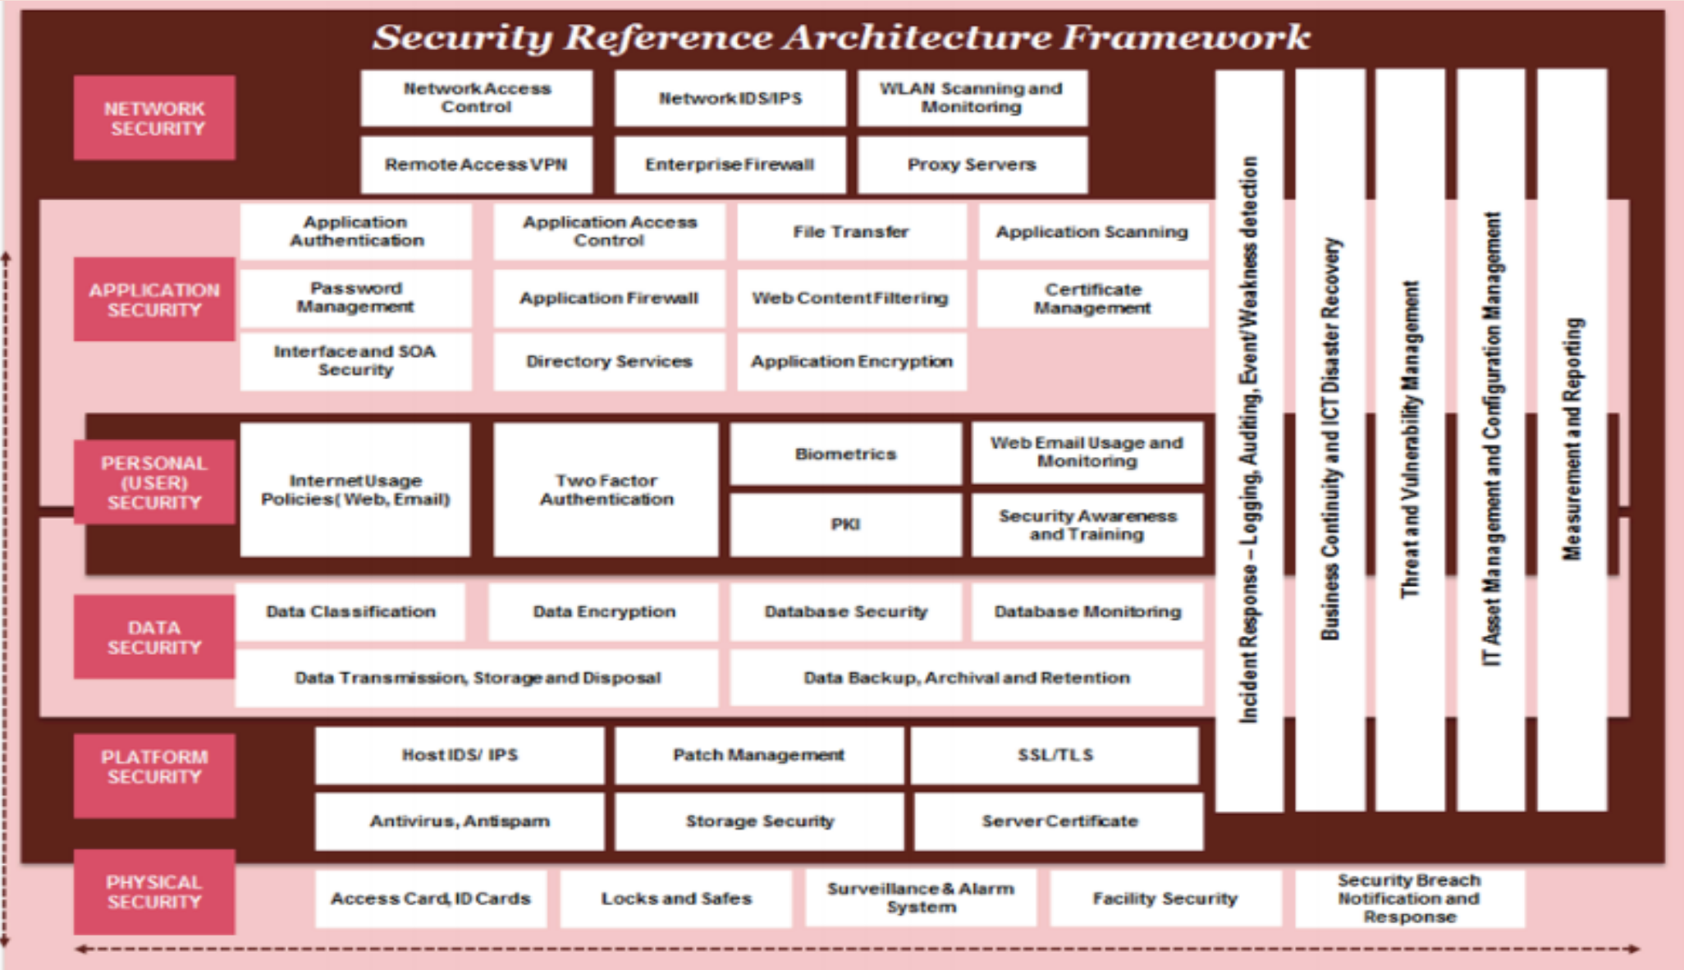

Slide 40
Security layers descriptions
Network Security: (authentication, firewall protection, network intrusion detections,)
Application Security: use of software, hardware, and procedural methods to protect applications from external threats.
Personnel/User Security: various authentication mechanisms for verification of user identify such as two-factor authentication, biometrics
Data Security: deals with security mechanism adopted for keeping data protected from corruption and unauthorized access to ensure data privacy
Platform /Host Security: Platform security deals with the security mechanisms adopted on servers, workstations and operating systems.
Physical Security: Physical security refers to the security characteristics concerned with restricting physical access by unauthorized personnel

Slide 41
Cross pillar
Incident Response: to address and manage any security breach or attack.
Business Continuity and ICT Disaster Recovery: ensure that essential business functions and ICT operations can continue during and after a disaster.
Threat and Vulnerability Management: to identify risks and mitigation control in the ICT environment.
ICT Asset Management: to manage ICT assets throughout their lifecycle
Measurement and Reporting: provides information on the health check of the ICT appliances and Systems.

Slide 42
Security Standard
Security standards are guidelines and best practices established to ensure the confidentiality, integrity, and availability of information, systems, and processes within an organization.
These standards help organizations protect their assets from various threats, including cyber attacks, unauthorized access, and data breaches.
Different industries and regions may have specific security standards, and compliance with these standards is often essential for regulatory and legal reasons.

Slide 43
Some Security Standards
ISO/IEC 27001: This is an international standard for information security management systems (ISMS). It provides a systematic approach to managing sensitive company information and ensuring its confidentiality, integrity, and availability.
NIST Framework for Improving Critical Infrastructure Cybersecurity: Developed by the National Institute of Standards and Technology (NIST) in the United States, this framework provides a set of standards, guidelines, and best practices for improving the cybersecurity posture of critical infrastructure organizations.
PCI DSS (Payment Card Industry Data Security Standard): Specifically designed for organizations that handle credit card transactions, PCI DSS outlines security requirements to protect cardholder data. Compliance is mandatory for businesses that process credit card payments.
HIPAA (Health Insurance Portability and Accountability Act): This U.S. standard is focused on protecting the privacy and security of patient information in the healthcare industry. It sets standards for the electronic exchange of health information.

Slide 44
GDPR (General Data Protection Regulation): Applicable to organizations operating within the European Union (EU), GDPR outlines rules and regulations concerning the protection of personal data of EU citizens. It applies to any organization, regardless of its location, that processes the personal data of EU residents.
CIS Controls (Center for Internet Security Controls): Developed by the Center for Internet Security, these controls provide a set of best practices to help organizations improve their cybersecurity posture and protect against common cyber threats.
FISMA (Federal Information Security Management Act): In the United States, FISMA sets guidelines and standards for securing federal government information systems. It requires federal agencies to develop, document, and implement information security programs.
SOC 2 (Service Organization Control 2): Developed by the American Institute of Certified Public Accountants (AICPA), SOC 2 defines criteria for managing and securing sensitive data stored in the cloud. It is often used by technology and cloud service providers to demonstrate their commitment to security.

Slide 45
Need of e-governance security standard
Security standards are crucial for e-governance to protect sensitive citizen data, ensure service delivery, and maintain public trust. Without robust security measures, e-government systems are vulnerable to cyber threats, data breaches, and privacy violations, potentially undermining the entire system and eroding public confidence.
Security standard is needed for
Protecting Sensitive Data:
  E-government systems handle vast amounts of personal and confidential information, including financial details, health records, and other sensitive data.
  Security standards help safeguard this information from unauthorized access, modification, or disclosure, preventing identity theft, fraud, and other malicious activities.

Slide 46
b) Ensuring Service Delivery:
  E-governance aims to provide efficient and reliable public services online.
  Security standards ensure the availability and integrity of these services, preventing disruptions caused by cyberattacks, malware, or other security breaches.
c) Maintaining Public Trust:
  Public trust is essential for the success of e-governance initiatives.
  When citizens feel confident that their data is secure and their transactions are protected, they are more likely to adopt and utilize e-government services.
  Security breaches can severely damage public trust, leading to reluctance in using online services and potentially undermining the entire e-governance project.
d) Preventing Financial Losses:
  Cyberattacks on e-government systems can result in significant financial losses for both the government and citizens.
  Security standards help mitigate these risks by preventing financial fraud, data breaches, and other malicious activities that could lead to financial losses.

Slide 47
e) Compliance with Regulations:
  Many countries have regulations and standards for data protection and cybersecurity.
  E-government systems need to comply with these regulations to avoid legal consequences and penalties.
f) Addressing Complexity of Systems:
  E-government systems often involve complex networks and interconnected systems.
  Security standards help address this complexity by providing a framework for managing security risks across different systems and platforms.

